Slide 1

Explore Indian Restaurants in the city of Toronto

Slide 2
Introduction
The project analyzes the neighborhoods in Toronto to look at the Indian restaurants in the area. This would help an entrepreneur make a better decision when choosing a location
Indian food is popular among the Asian community. It is wise to understand the Toronto community and anticipate the number of customers who would be willing to visit the restaurant.

Slide 3
Data
The project requires the following data :
Data for the Toronto neighborhoods and zip code from the Wikipedia webpage
The longitude and latitude coordinates from https://cocl.us/Geospatial_data
Nearby venues in the neighborhood of Toronto city using Foursquare API

Slide 4
Approach
Web scrape the Toronto neighborhood and borough data
Use FourSquare API to find all venues for each neighborhood
Refine the data frame to prepare it for clustering
Visualize the k-means clusters using folium library of Python

Slide 5
Results

Slide 6
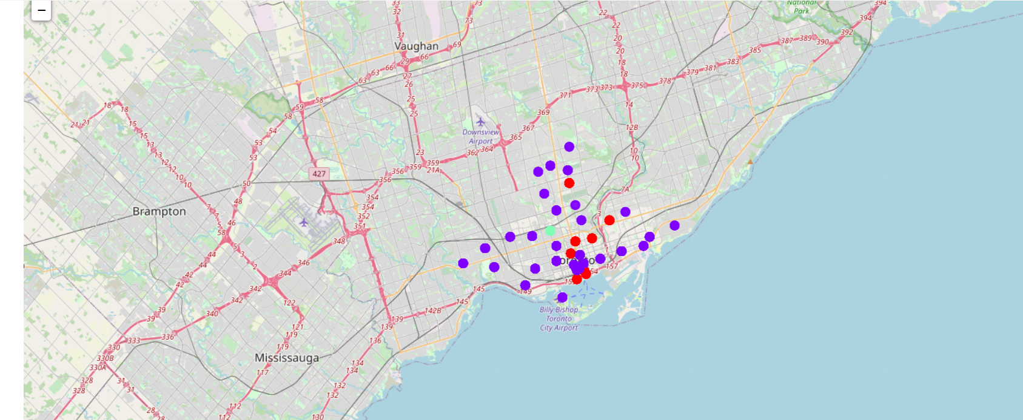

Slide 7
Conclusion
Most of the Indian restaurants are in cluster 0 which is around Central Bay Street, Church and Wellesley, Berczy Park, Union Station, Richmond, lowest in cluster 1 areas which are in North Toronto West and Parkade areas.
There are good opportunities to open near St James Town, Cabbagetown
Cluster 2 might be a good location as there are not a lot of Indian restaurants in that area

